Slide 1


Zomato Data Analysis and Insights
This presentation delves into a comprehensive analysis of Zomato's global presence, identifying key opportunities and challenges across various regions. We will explore Zomato's strengths and weaknesses in each market, highlighting potential solutions for growth and expansion.
Group – 4

Slide 2
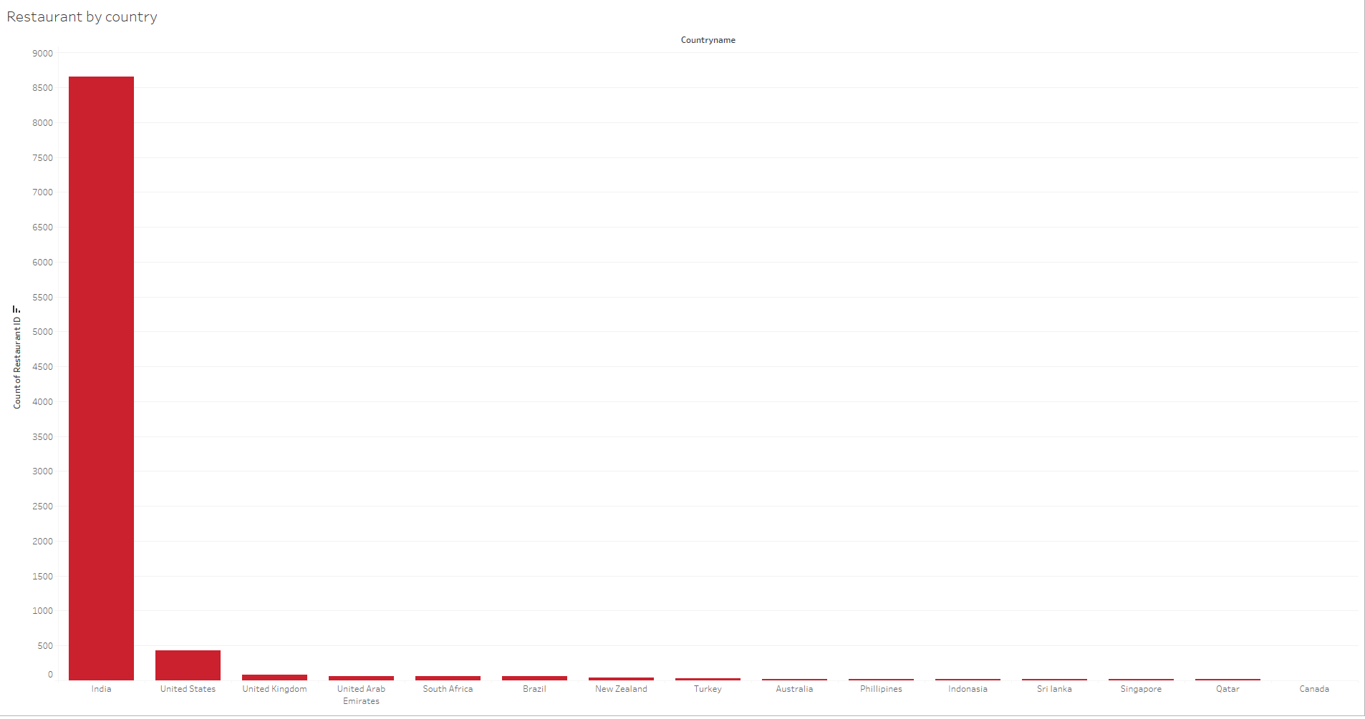
Country-wise Presence: A Global Perspective

Slide 3
India: Dominance and Challenges
Australia: Competitive Landscape
Brazil: High Potential, Emerging Market
Zomato enjoys a dominant presence in India, boasting the highest number of restaurants on its platform. However, challenges include market saturation and potential service quality concerns.
Zomato faces stiff competition in Australia, characterized by a smaller restaurant base and established local players like Menulog and UberEats. Strategic partnerships and tailored marketing campaigns are essential for success.
Brazil presents a promising market for Zomato, with limited existing presence but high potential for growth. However, economic challenges and logistics issues present hurdles.
Expanding to Tier-2/3 cities: Targeting untapped markets can provide fresh growth opportunities.
Forming Partnerships: Collaborating with local businesses can offer access to new customer segments and marketing channels.
Creating Localized Offers: Adapting pricing and menu options to cater to local preferences is vital.
Investing in Training Programs: Enhancing service quality through comprehensive training for restaurant staff is crucial.
Investing in Logistics: Establishing efficient delivery networks is crucial for expanding service reach.
Tailoring Marketing Campaigns: Adapting messaging and promotional strategies to resonate with the Australian market is critical.

Slide 4

Canada: Addressing the Competitive Landscape
1
Limited Restaurant Base
2
Intense Competition
The Canadian market is characterized by a smaller number of restaurants compared to other regions. Zomato needs to strategize to attract more restaurants to its platform.
Zomato faces intense competition from established players in the Canadian market like DoorDash and SkipTheDishes. Differentiating its offerings and value proposition is critical.
3
Investing in Brand Awareness
4
Exclusive Deals and Incentives
To stand out, Zomato should invest in robust marketing campaigns to build brand awareness and attract users in Canada.
Offering exclusive deals and incentives for users can help Zomato gain market share in Canada's competitive food delivery landscape.

Slide 5
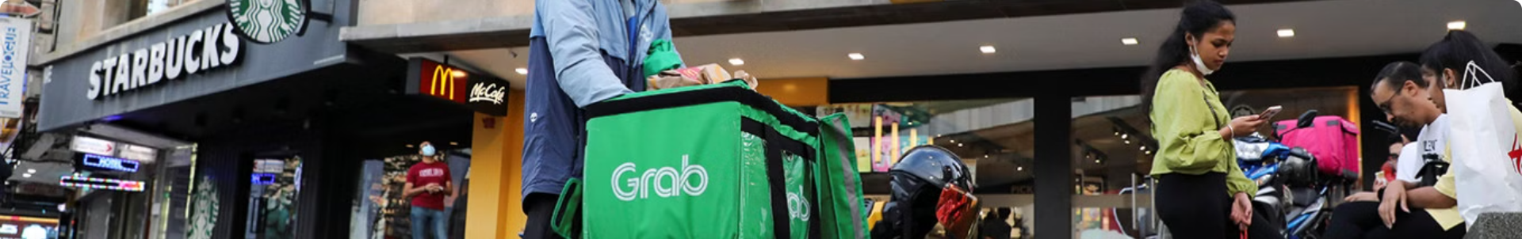
Indonesia: Navigating Cultural Differences
Limited Restaurant Presence
Cultural Nuances
Zomato's presence in Indonesia is relatively small, requiring strategic efforts to onboard more restaurants and adapt to local preferences.
Understanding local culinary customs and preferences is crucial for Zomato's success in Indonesia, necessitating a tailored approach.
Partnering with Local Services
Compliance with Local Regulations
Collaborating with local delivery networks and food ordering platforms can accelerate Zomato's penetration in the Indonesian market.
Zomato must comply with Indonesian regulations governing food delivery and online businesses, ensuring its operations are legally sound.

Slide 6
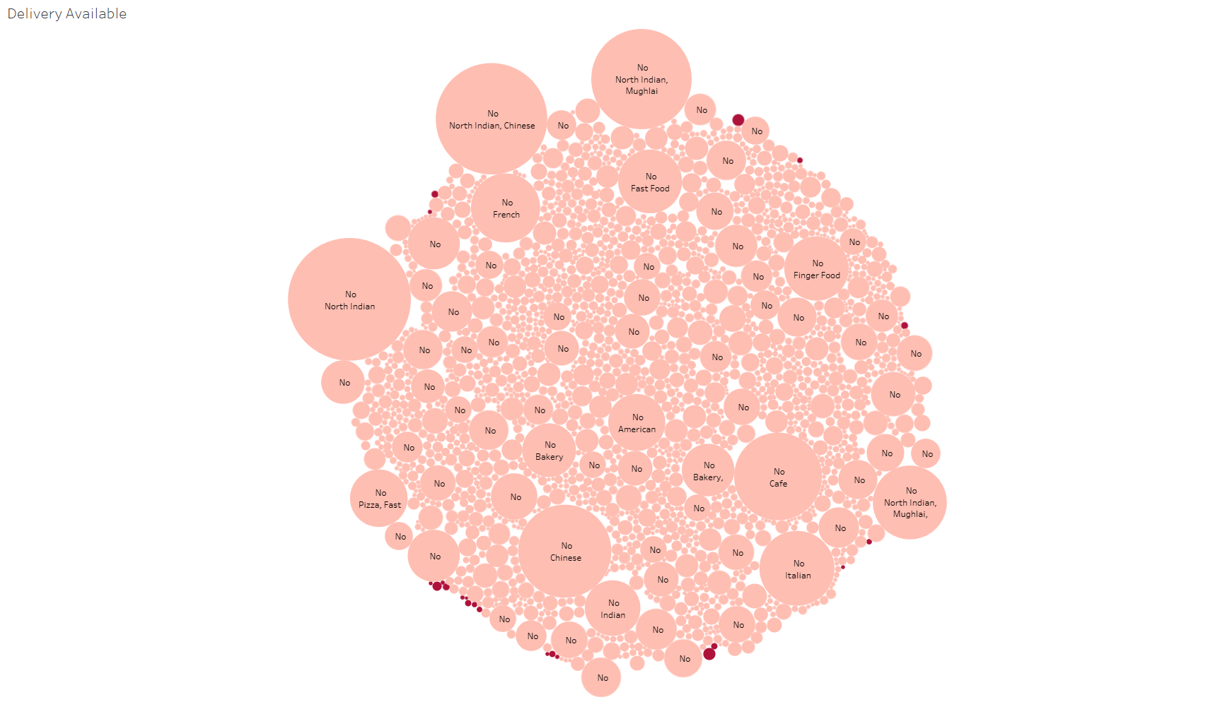
Cuisines Delivery Availability as per Sales

Slide 7
Delivery Availability: Addressing Challenges
1
Logistics and Infrastructure
Insufficient delivery fleet size and inadequate personnel can lead to delays and poor service. Expanding the fleet and partnering with third-party services can address this issue.
2
Restaurant Capacity
Restaurants may struggle to handle online orders efficiently. Providing training and optimizing kitchen processes can streamline operations and improve delivery times.
3
Technology and Integration
Lack of proper integration between Zomato's platform and restaurant systems can lead to delays and inaccuracies. Ensuring seamless integration and implementing real-time tracking are key solutions.
4
Geographical Limitations
Poor network coverage can restrict delivery areas. Establishing delivery hubs and using dynamic coverage areas can expand service reach to underserved areas.
5
Economic Constraints
High delivery costs can hinder affordability. Implementing dynamic pricing based on distance and demand, and offering incentives for users, can address cost concerns.
6
Regulatory Challenges
Restrictive local regulations can pose hurdles for Zomato's operations. Ensuring compliance with regulations and engaging with local authorities are essential for smooth operations.

Slide 8
Delivery Availability: Addressing Challenges
6
Regulatory Challenges
Restrictive local regulations can pose hurdles for Zomato's operations. Ensuring compliance with regulations and engaging with local authorities are essential for smooth operations.

Slide 9
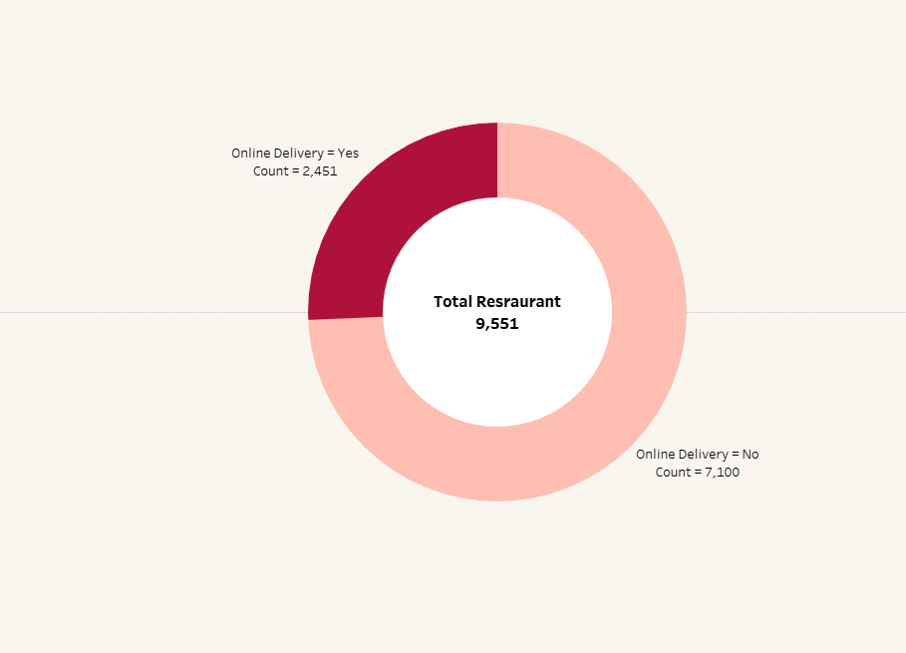
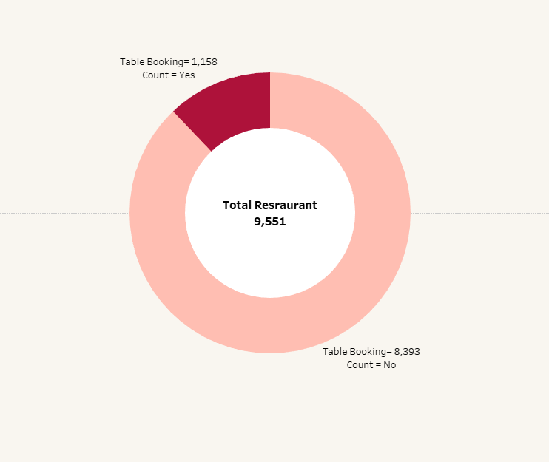
Table Booking & Online Deliver

Slide 10




Table Booking: Optimizing Operational Efficiency
Reservation Systems
Incentivizing Table Bookings
Dynamic Policies
Implementing user-friendly reservation systems that integrate with restaurant databases can streamline the booking process for customers and restaurants.
Enabling restaurants to set dynamic policies based on availability, time slots, and party size can optimize table management and customer satisfaction.
Offering exclusive deals, loyalty points, or discounts for table bookings can encourage customers to use this feature, benefiting both Zomato and restaurants.

Slide 11

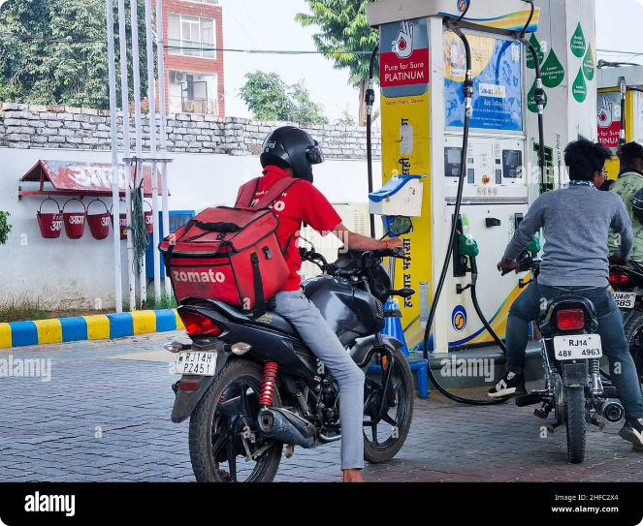



Online Delivery: Enhancing Service Quality
Logistical Optimization
Zomato should invest in optimizing delivery routes, utilizing efficient delivery networks, and implementing real-time tracking to ensure timely deliveries.
Cost Management
Subsidizing delivery fees, especially during promotional periods, can attract customers and encourage increased usage of Zomato's online delivery service.
Technical Support
Providing readily available technical support for restaurants and users facing issues with the online delivery platform can enhance overall user experience.

Slide 12

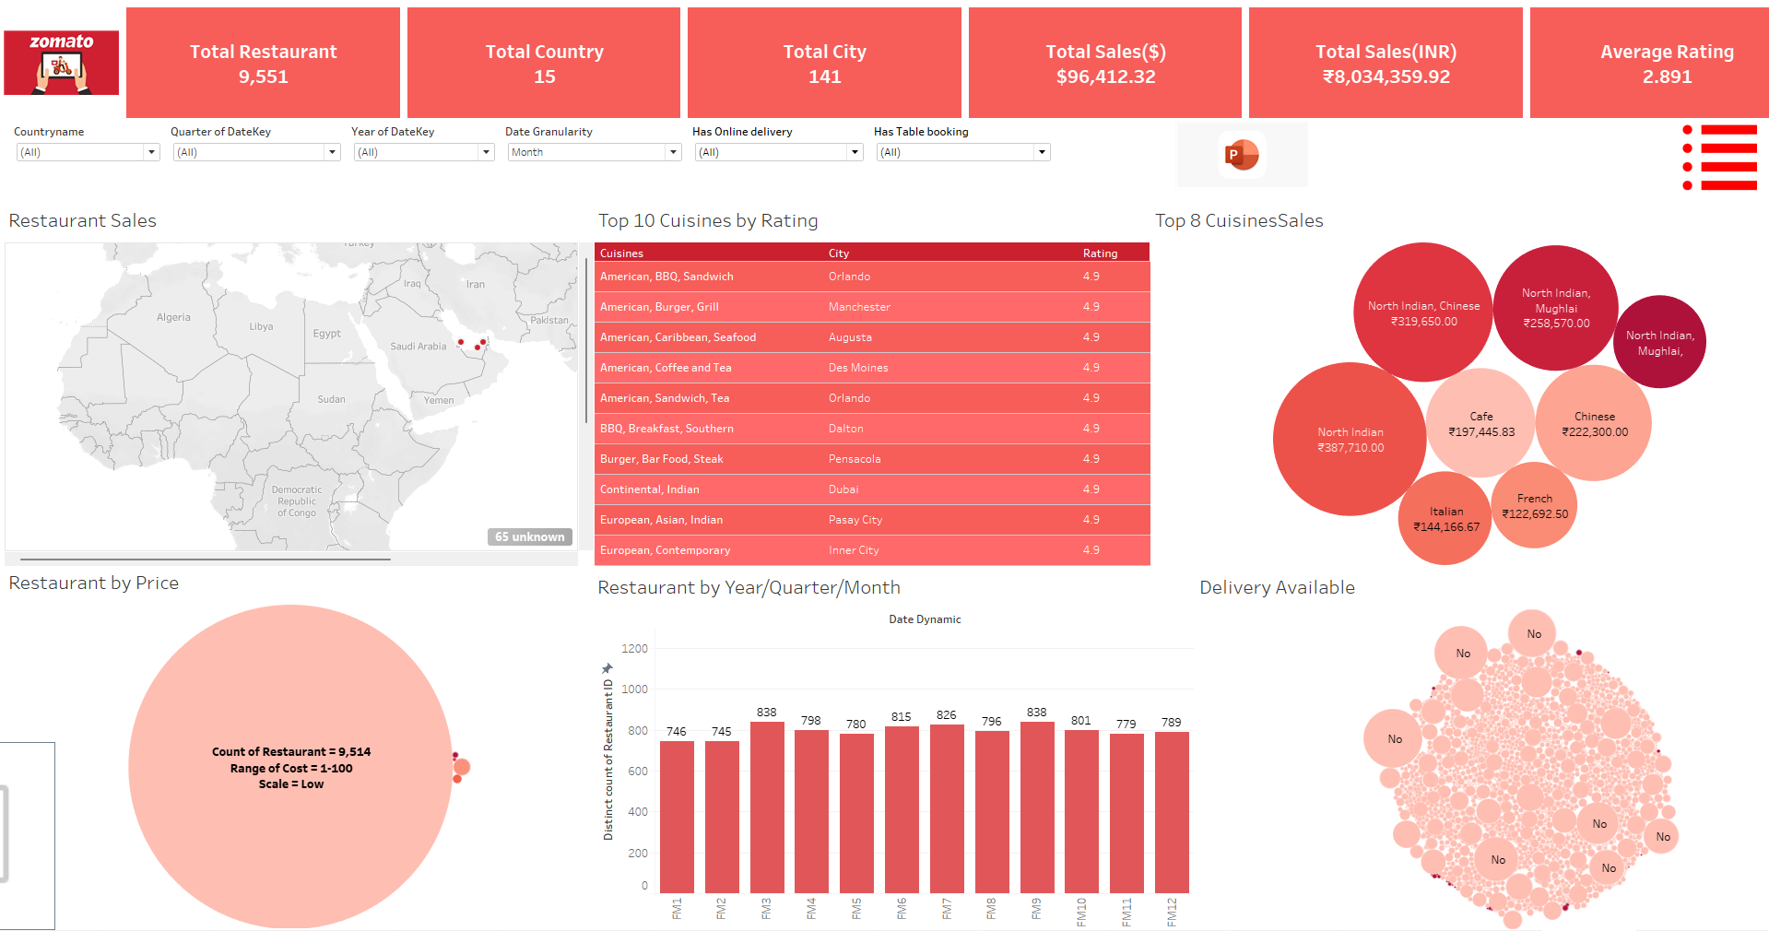
Data-Driven Insights: Unveiling Market Trends
Metric
Insight
Action
Restaurant Popularity
Identify trending cuisines and dishes
Promote popular options, personalize recommendations
Delivery Demand
Understand peak hours and geographic patterns
Optimize delivery routes, adjust pricing dynamically
User Feedback
Analyze customer reviews and ratings
Identify areas for improvement, personalize user experience

Slide 13

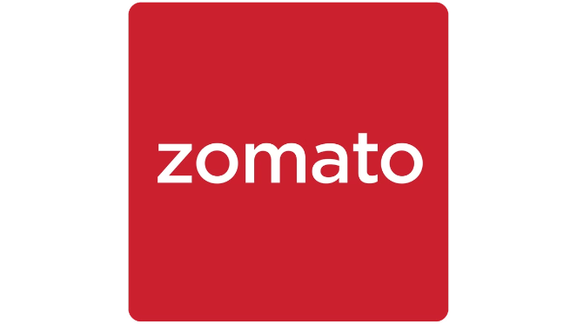
Strategic Partnerships: Expanding Reach
1
Local Food Delivery Platforms
Partnering with local food delivery services in emerging markets can provide access to new customer bases and accelerate Zomato's expansion.
2
Restaurant Management Software Providers
Collaborating with restaurant management software companies can streamline integration and enhance data sharing between Zomato and its restaurant partners.
3
Payment Gateways
Partnering with popular payment gateways can offer users a wider range of secure and convenient payment options, increasing conversion rates.
4
Marketing and Advertising Platforms
Partnering with marketing and advertising platforms can reach a broader audience, promoting Zomato's services and special offers effectively.

Slide 14


Conclusion: Building a Sustainable Future
By implementing the strategies outlined in this presentation, Zomato can address critical challenges, enhance customer satisfaction, and drive sustainable growth across various regions. Key takeaways include: investing in technology and logistics, fostering strategic partnerships, and prioritizing a data-driven approach to decision-making. This comprehensive strategy positions Zomato for continued success and expansion in the evolving global foodtech landscape.

Slide 15
Thank You

